Slide 1

Harapan adalah bentuk dasar dari kepercayaan akan sesuatu yang diinginkan akan didapatkan atau suatu kejadian akan berbuah kebaikan di waktu yang akan datang.
HARAPAN adalah apa yang Tuhan inginkan terjadi sedangkan IMPIAN adalah apa yang kita inginkan terjadi.

Slide 2
Bagaimana caranya hidup mengandalkan Tuhan?
Pertama, Jangan pernah menggantikan - SUMBER DAYA rohani (yang tak terbatas) dengan - sumber daya duniawi (yang terbatas) (baca: Ef. 6:13-18).
Kedua, BERUSAHAlah semaksimal mungkin, tetapi serahkanlah hasilnya pada Tuhan. Mengandalkan Tuhan bukan berarti meniadakan usaha, namun berusaha dengan cara pandang bahwa Tuhanlah yang berdaulat (Ayb. 42:2).
Ketiga, TAATlah pada pimpinan Tuhan. Mintalah kekuatan pada Kristus, yang terlebih dulu “taat sampai mati di kayu salib” demi menebus dosa kita (Flp. 2:8). Amin.
Notes:
Hidup yang Mengandalkan Tuhan
https://gbtkristuspelepas.org/hidup-yang-mengandalkan-tuhan-yer-175-8/

Slide 3

Fakultas Ilmu Komputer
Learning is the process of acquiring new understanding, knowledge, behaviors, skills, values, attitudes, and preferences.
Hide Methods from Public Access

Slide 4

Welcome to the Framework Programming course

Slide 5

1 - Pass the value via URL

Slide 6
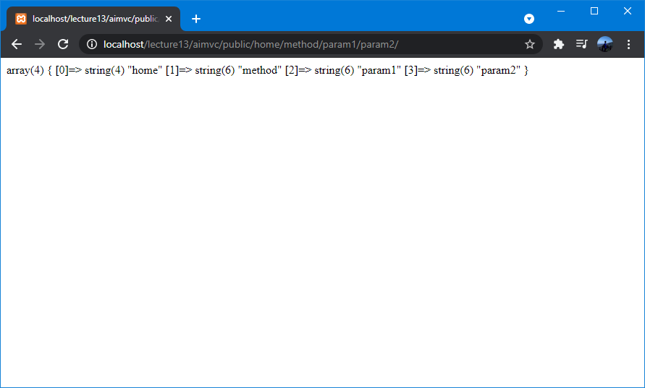
Handle Input Data from URL
Index[0]
Index[1]
Index[2]
Index[3]
Controller
Method
Parameter #1
Parameter #2
Our app starts from this directory location:
http://localhost/lecture13/aimvc/public/
This means Controller default (home) and method default (index).
URL Format: http://localhost/lecture13/aimvc/public/class/method/param1/param2/
Notes:
https://codeigniter.com/userguide3/general/controllers.html

Slide 7
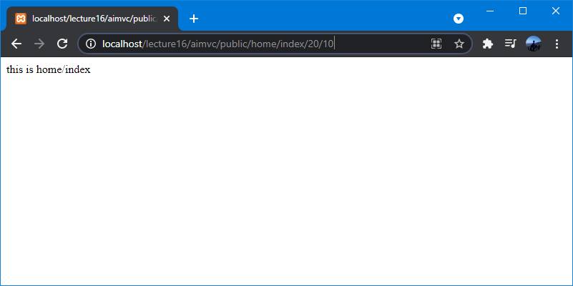
Handle Input Data from Default Method
Default method can be accessed through these URLs:
http://localhost/lecture16/aimvc/public/home/index/
http://localhost/lecture16/aimvc/public/home/

Slide 8
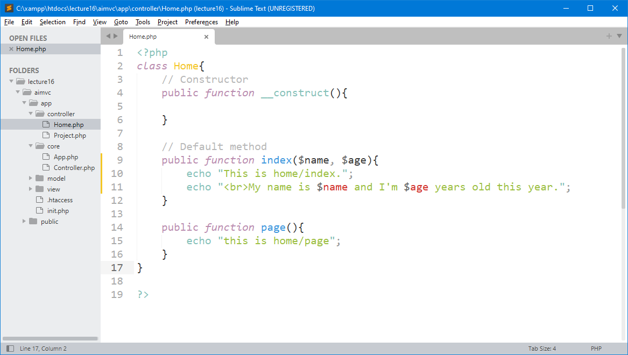

Handle Input Data from Default Method
PHP Function Arguments, Information can be passed to functions through arguments. An argument is just like a variable. Arguments are specified after the function name, inside the parentheses.

Slide 9
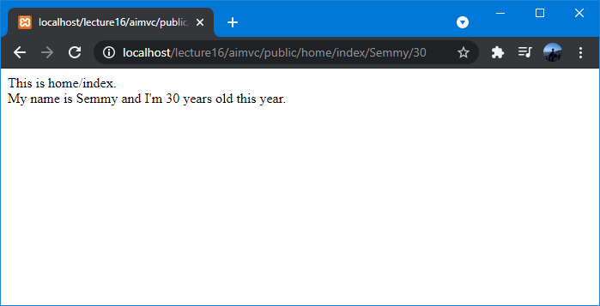
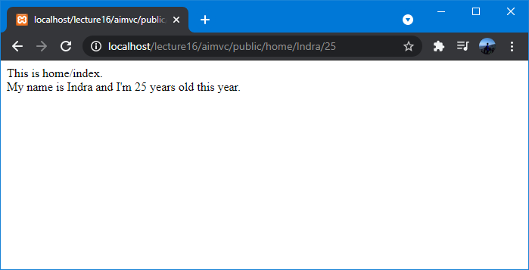
Handle Input Data from Default Method

Slide 10
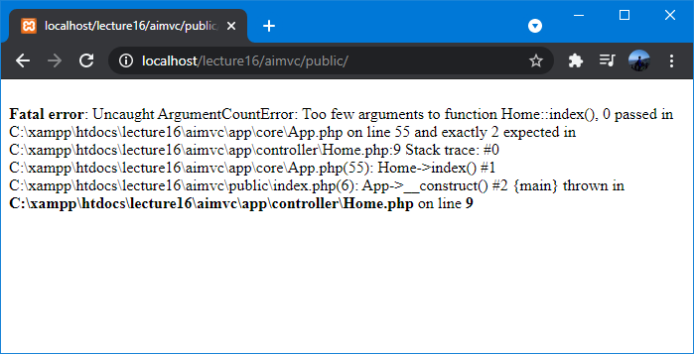
Why Fatal Error?
There’re no default parameters in this method. You may need to remember this, when you create a method with parameters, you should provide the method with default parameters.

Slide 11
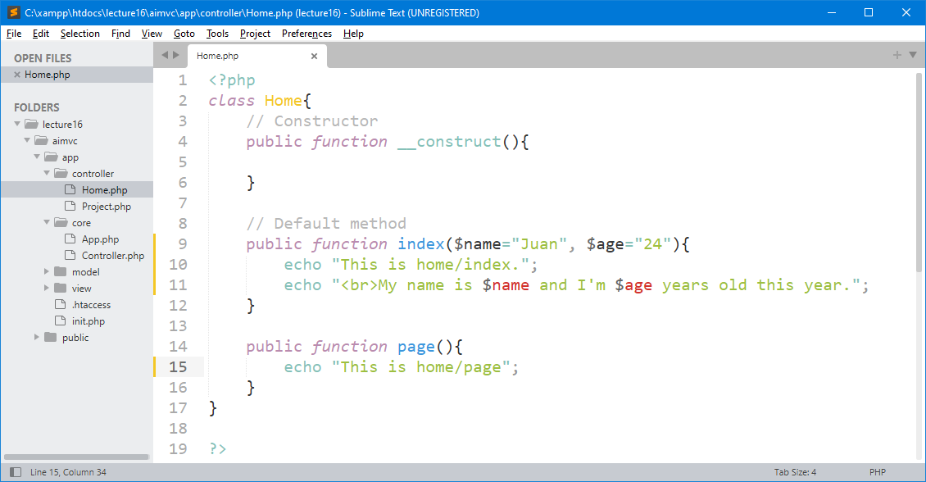
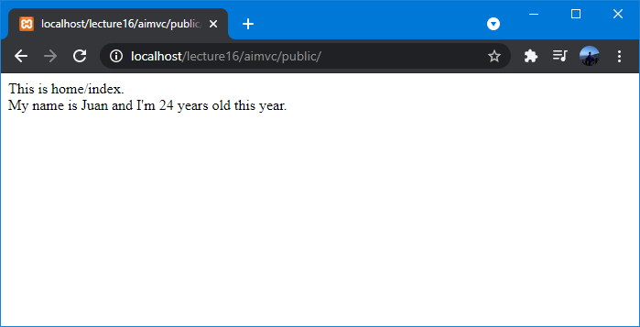
Default Values for Function Parameters

Slide 12
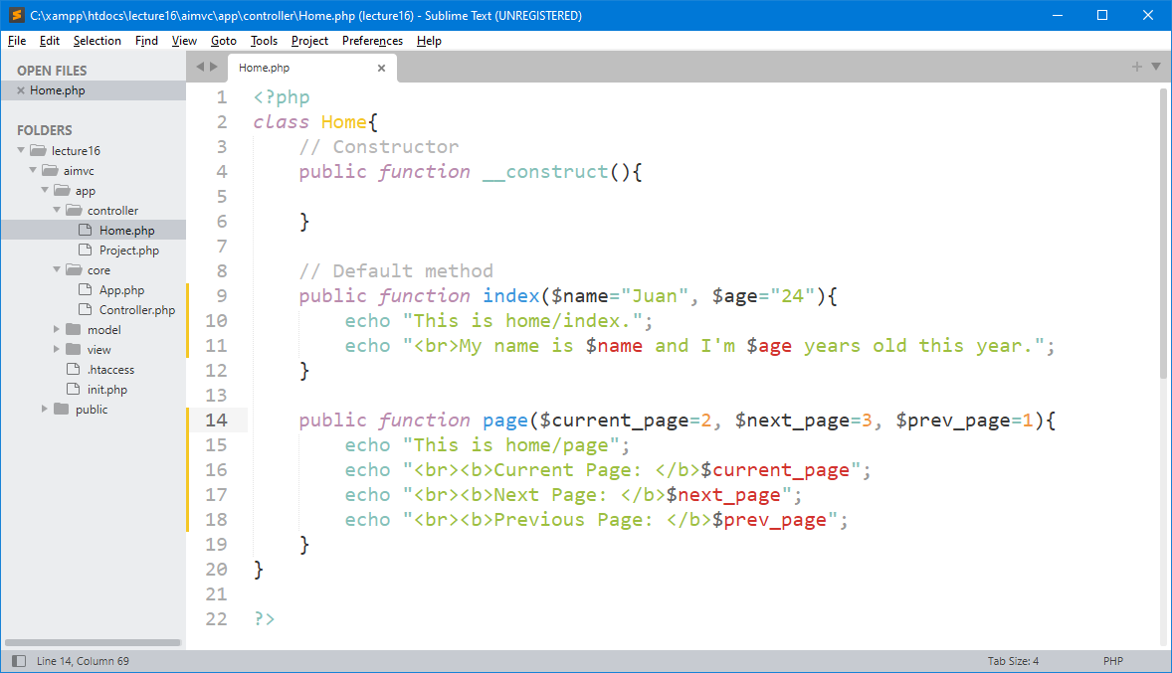
Many Arguments from URL Request
You can add as many arguments as you want, just separate them with a comma.

Slide 13
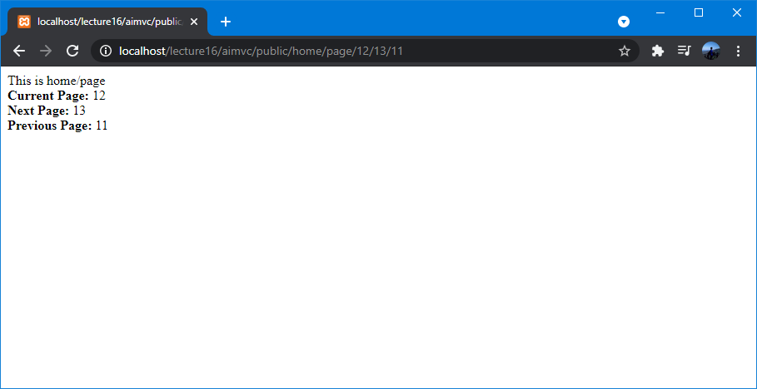
Many Arguments from URL Request
We added three arguments as a parameter input for the method in class controller, we separate data with a comma.

Slide 14
2 - Prevent Direct Access Methods

Slide 15
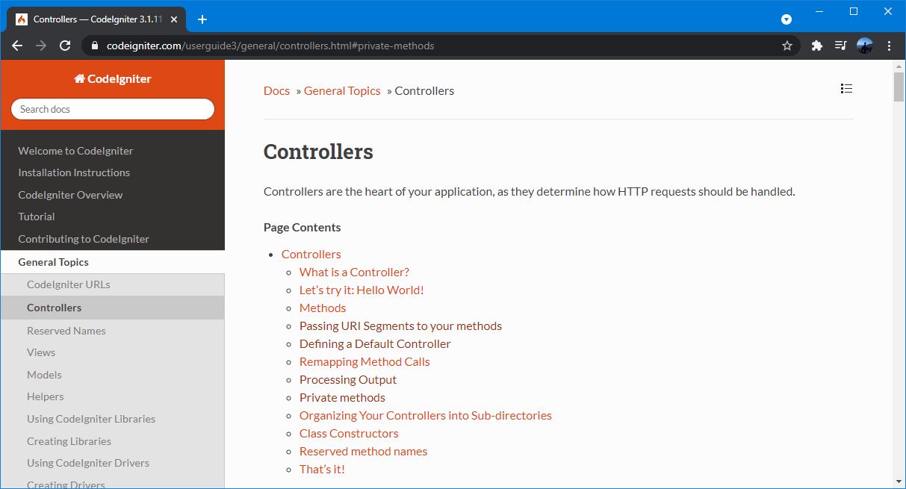
Controllers in CodeIgniter
Link: https://codeigniter.com/userguide3/general/controllers.html

Slide 16
How to prevent direct access methods in controller class?

Slide 17
How to Prevent Direct Access Methods?
In some cases we may want certain methods hidden from public access, so there’s no direct access to a method. In order to achieve this, simply declare the method as being private or protected and it will not be served via a URL request.
We can create private or protected functions in the class controller by using the underscore prefix.

Slide 18
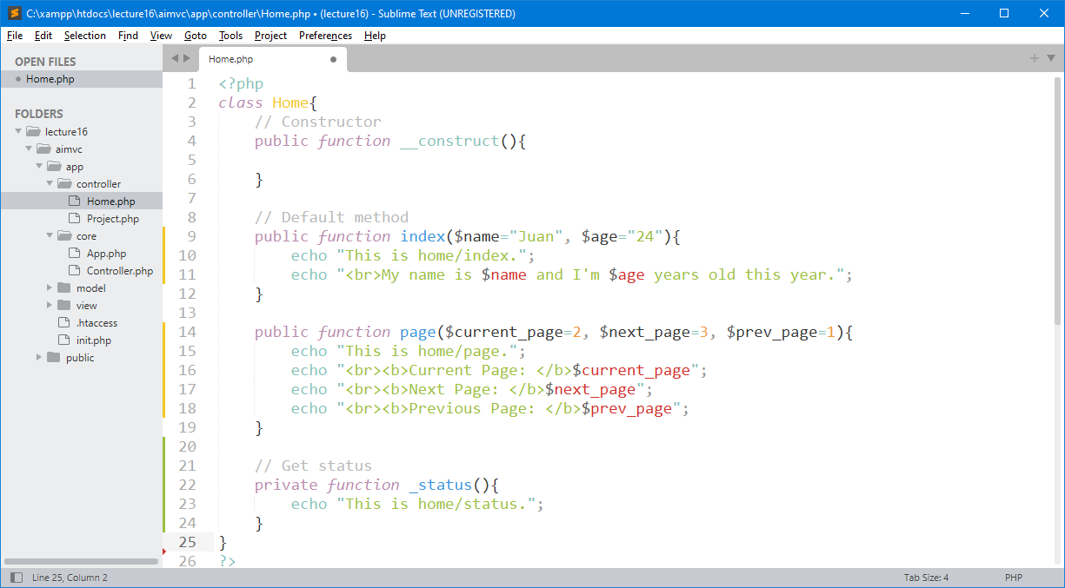
Close Direct Access - Private Methods
Prefixing method names with an underscore will also prevent them from being called from URL. This is a legacy feature that is left for backwards-compatibility.

Slide 19
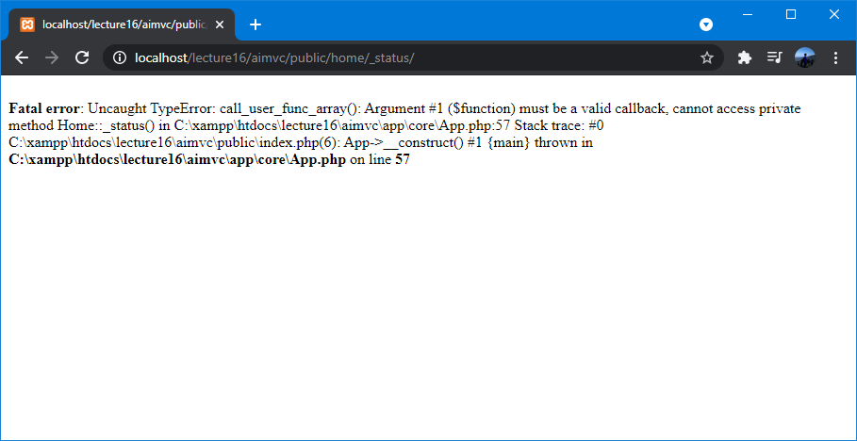
Try to access private method via the URL
Browser returns an fatal error must be a valid callback, cannot access private method.

Slide 20
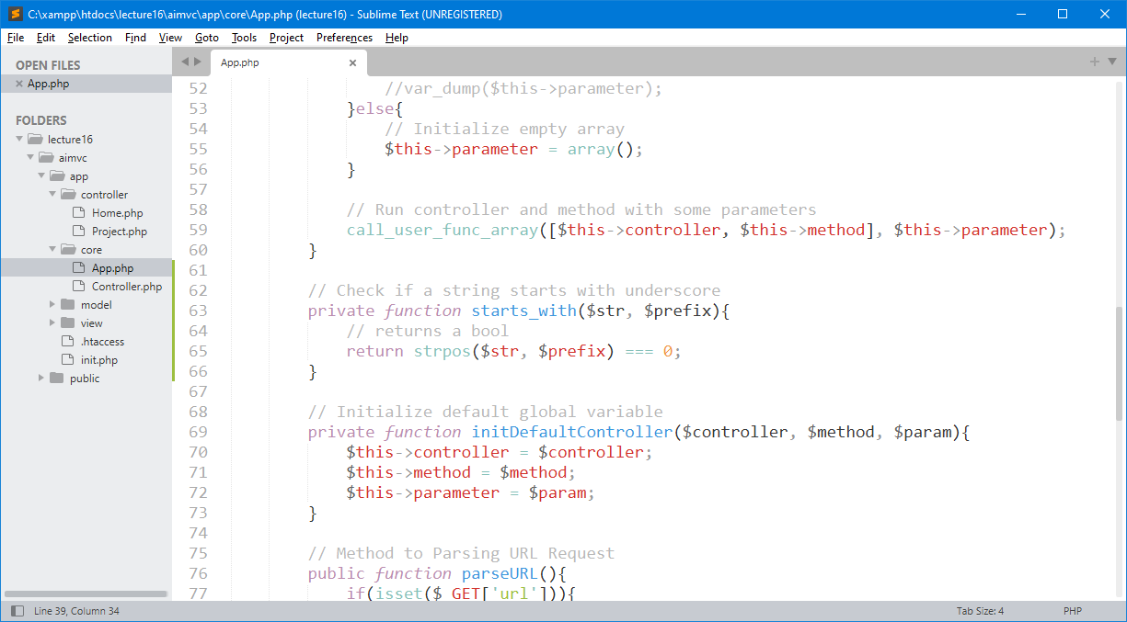
Create a Function to Check Underscore

Slide 21
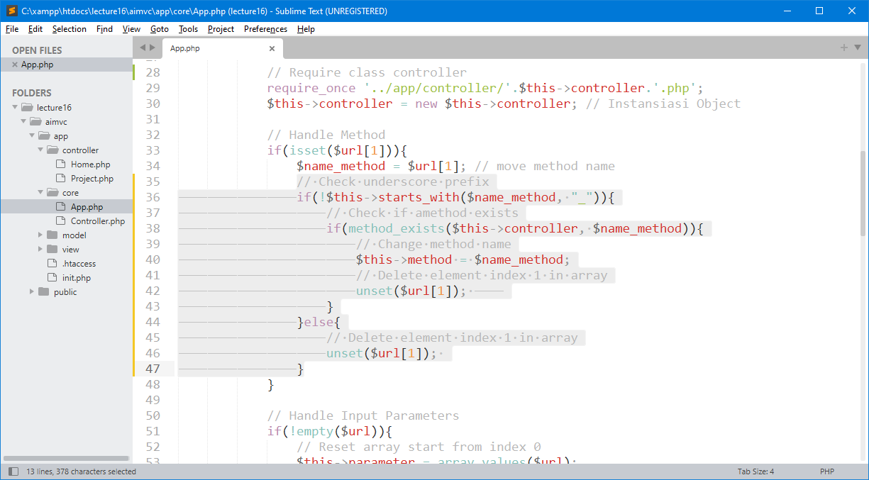
Update your Core App.php File
Remove this item from array, so it can’t be recognized as an input parameter for the next segment.

Slide 22
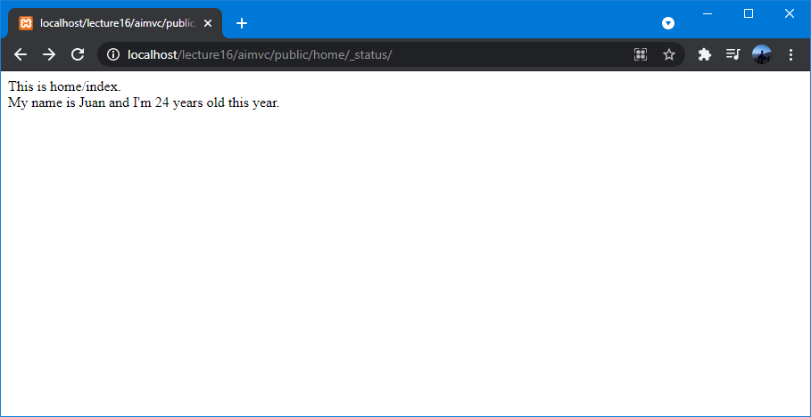
Final Testing - Direct Access Methods
Now, we can completely Prevent Direct Access Methods from URL and even try to handle underscore prefix from core App.php file.

Slide 23

exercise for students

Slide 24
Latihan untuk Students
Create directory : C:\xampp\htdocs\lecture16\
Create file : _.php
Buat semua contoh yang sudah di pelajari sebelumnya.

Slide 25

THANK YOU
END PRESENTATION
Thank you for your attention
Instructor: S – W – T

